Slide 1






Foundations of
Quantum Information Science (QIS 101)
Dave Biersach
Brookhaven National Laboratory
dbiersach@bnl.gov
Session 01
Introducing
Quantum Computing

Slide 2



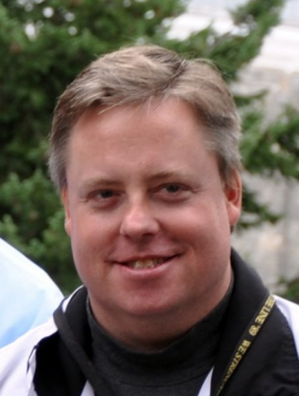

Welcome!
My name is Dave Biersach
I am a Senior Technology Architect at BNL
I am a 1989 graduate of the United States Military Academy at West Point, and I served in the Persian Gulf War as a Combat Engineer
I worked for DARPA developing satellite counter-reconnaissance search algorithms
I have worked at Microsoft & Pfizer
I have been married 30 years, have three adult children, and have mentored students for the past 15 years

Slide 3
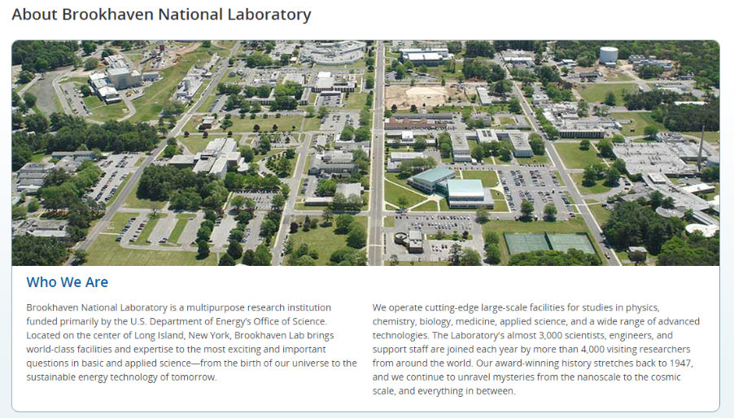

Slide 4
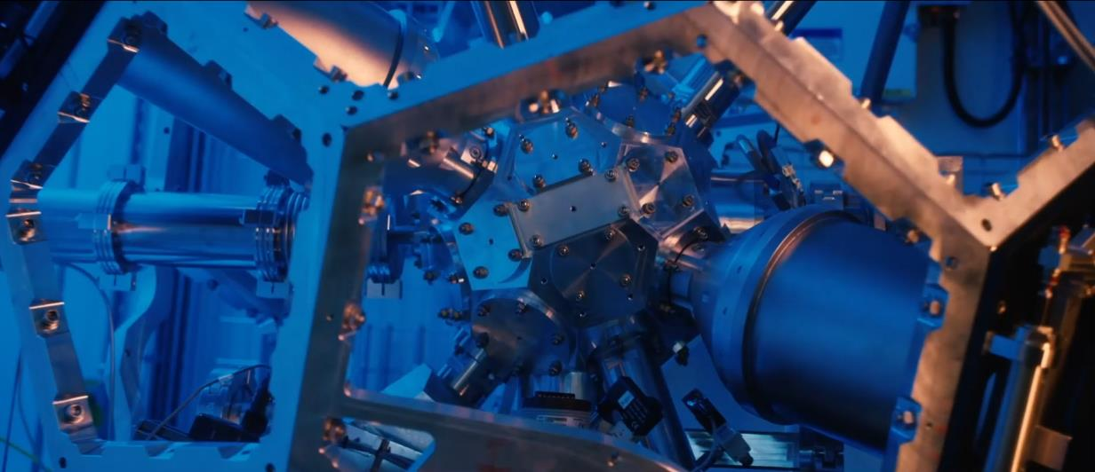
About Brookhaven National Laboratory
https://www.youtube.com/watch?v=csgXRPV0R3A

Slide 5
Agenda
Defining Scientific Computing
Differentiating SciComp from CompSci
SciComp as a Translational Science
Scientific Computing and STEM Internships
How Quantum Computing Relates to SciComp
Workshop Context & Topics
Workshop Expectations

Slide 6
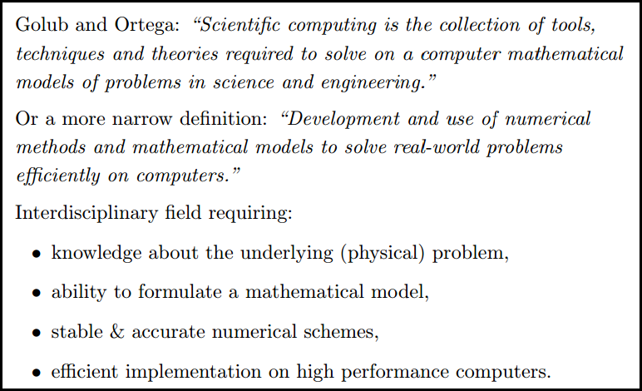
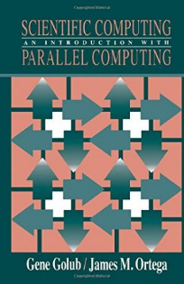
What is Scientific Computing?

Slide 7

What is Scientific Computing?
Scientific computing problems cannot be solved using just a graphing calculator or a spreadsheet program
A computer should not be viewed as just another closed-form benchtop instrument with fixed functionality
SciComp does not require writing thousands of lines of code to answer problems – complete code usually fits on one slide!
SciComp is applied computer science
The first name of CompSci is computer
The first name of SciComp is science
A triple helix of math, science, and computing

Slide 8
SciComp vs CompSci
Scientific Computing
Computer Science
Probability and Statistics
Simulation and Modelling
Data Visualization
Storing and Analyzing Very Large Datasets
Parallel & Distributed Algorithms
Speed and Accuracy Paramount
Functional Languages
Open-Ended Problems with Unknown Solutions
General Data Structures
Design Methodologies
Procedural Languages
Stand-Alone Programs
Emphasis on Object-Orientation
Simple Data Models
Sequential Algorithms
Less Graphics Intensive
Directed Closed-Form Problems with Known Solutions

Slide 9
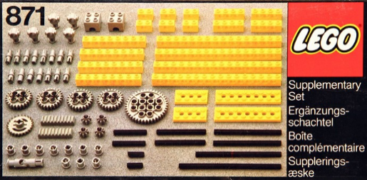
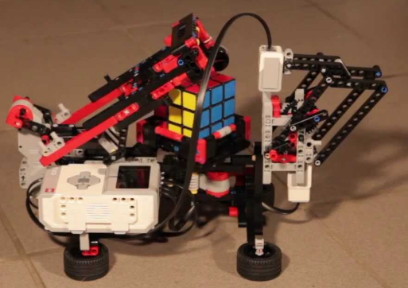
SciComp = Just Enough CompSci
Data types: int, float, bool, string
Data structures: lists, arrays, dictionaries, classes, modules
Functions: def, return
Statements: if, for, while, break
Patterns: vectorization, divide & conquer, map-reduce
Algorithms: GCD, mean/variance, sorting, searching
Modules: numpy, matplotlib, numba, scipy, sympy, scikit-learn

Slide 10
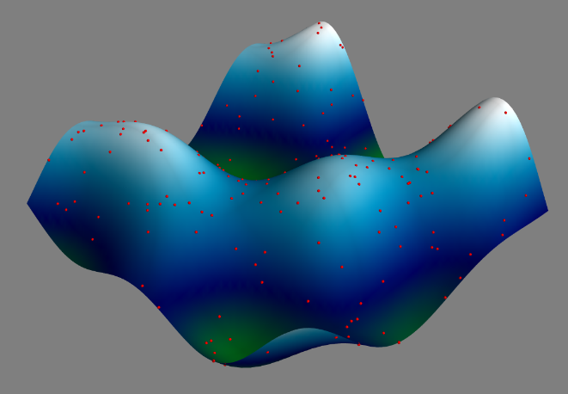
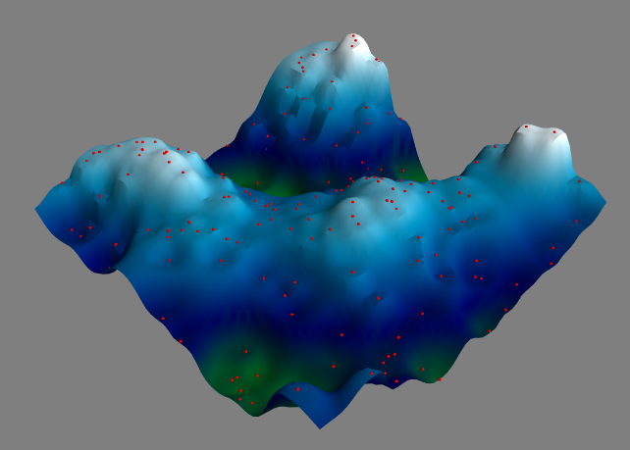
Example SciComp Topic Multidimensional Interpolation
A first order 3-D approximation of the ocean floor based upon only 220 sample (red) points (sonar timings)

Slide 11
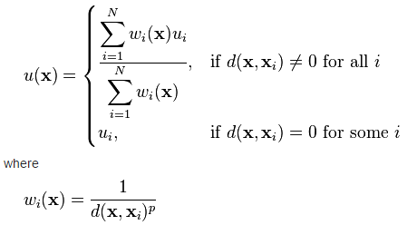
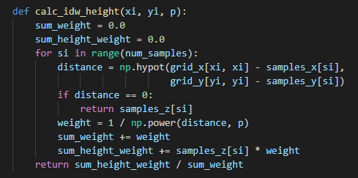
SciComp As Translational Science
"The algorithm that almost won the cold war"
11 lines of code can change the world!
SciComp is the ability to translate mathematical expressions of scientific concepts into correct and efficient software code

Slide 12
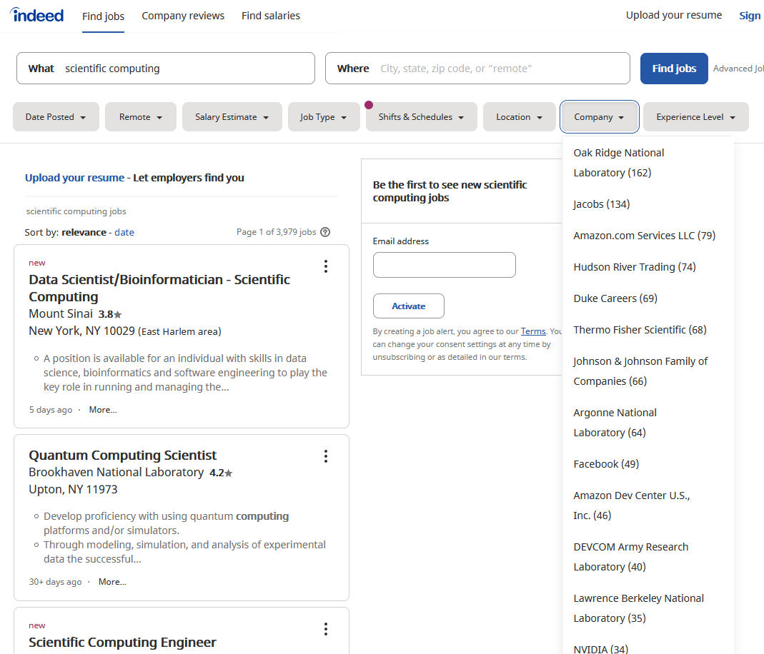
SciComp = The Pathway to Internships

Slide 13
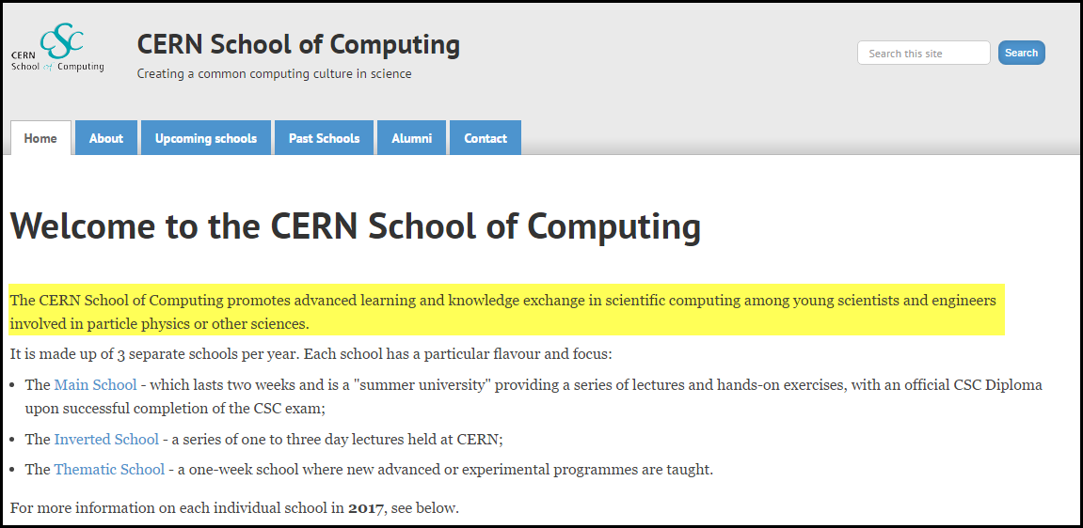
SciComp = The Pathway to Internships
High school interns at CERN are required to complete a course in Scientific Computing before they can begin their internship.
That is how important CERN views these skills!

Slide 14
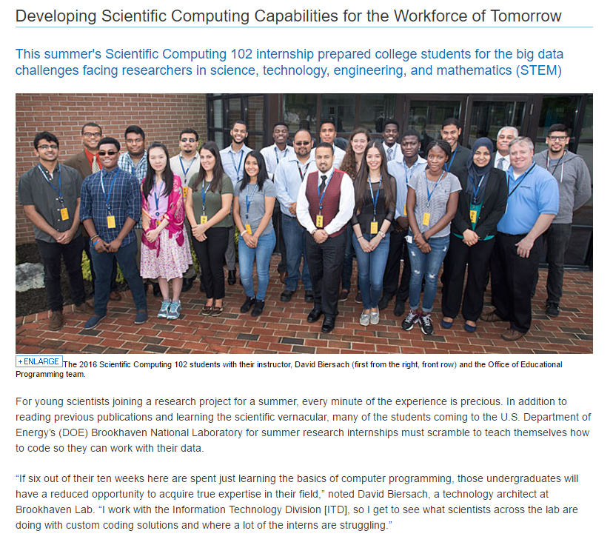
https://www.bnl.gov/newsroom/news.php?a=26599

Slide 15
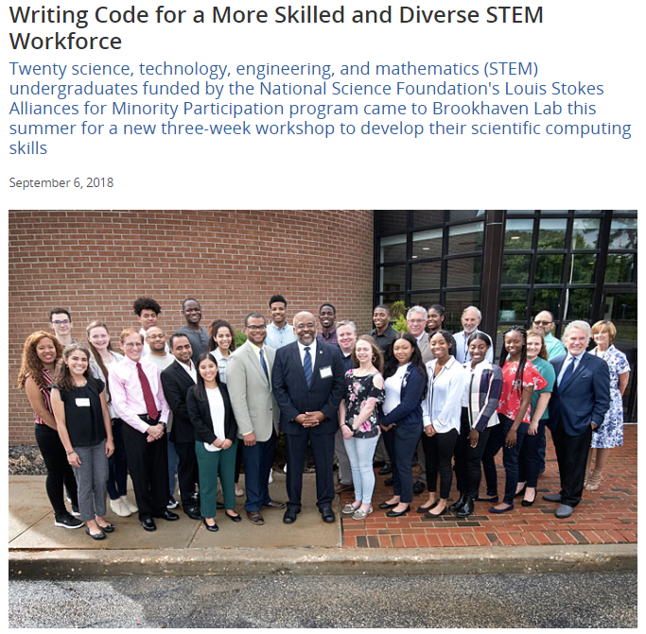
https://www.bnl.gov/newsroom/news.php?a=213064

Slide 16
About Your Fellow Participants
We welcome 45 students from around the USA
CA, IL, KY, LA, MA, MD, MS, NJ, NY, PA, PR, RI, TN, TX
The are two teaching assistants here (TA) to help you
We cherish and protect diversity and inclusion
85% are Black/African, Hispanic/Latino, Native American
52% are female, two students are LGBTQ/Cis/Non-Binary
Experience varies widely within this group
52% are freshmen or sophomore undergraduates
50% have never taken a course in computer programming
25% have never taken a course in calculus or physics

Slide 17
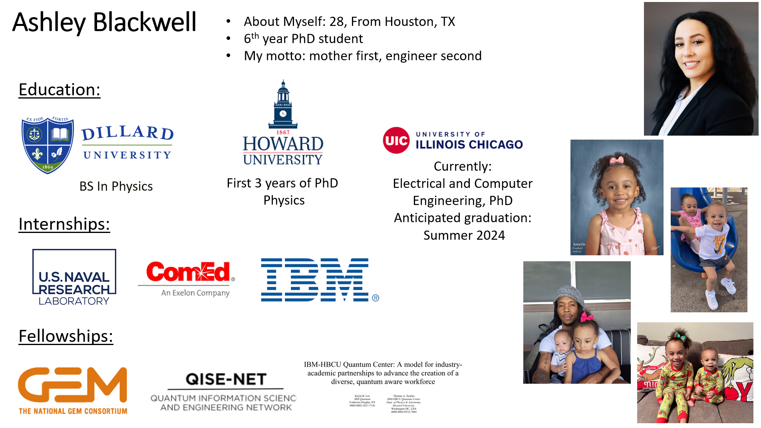
Your Teaching Assistants

Slide 18
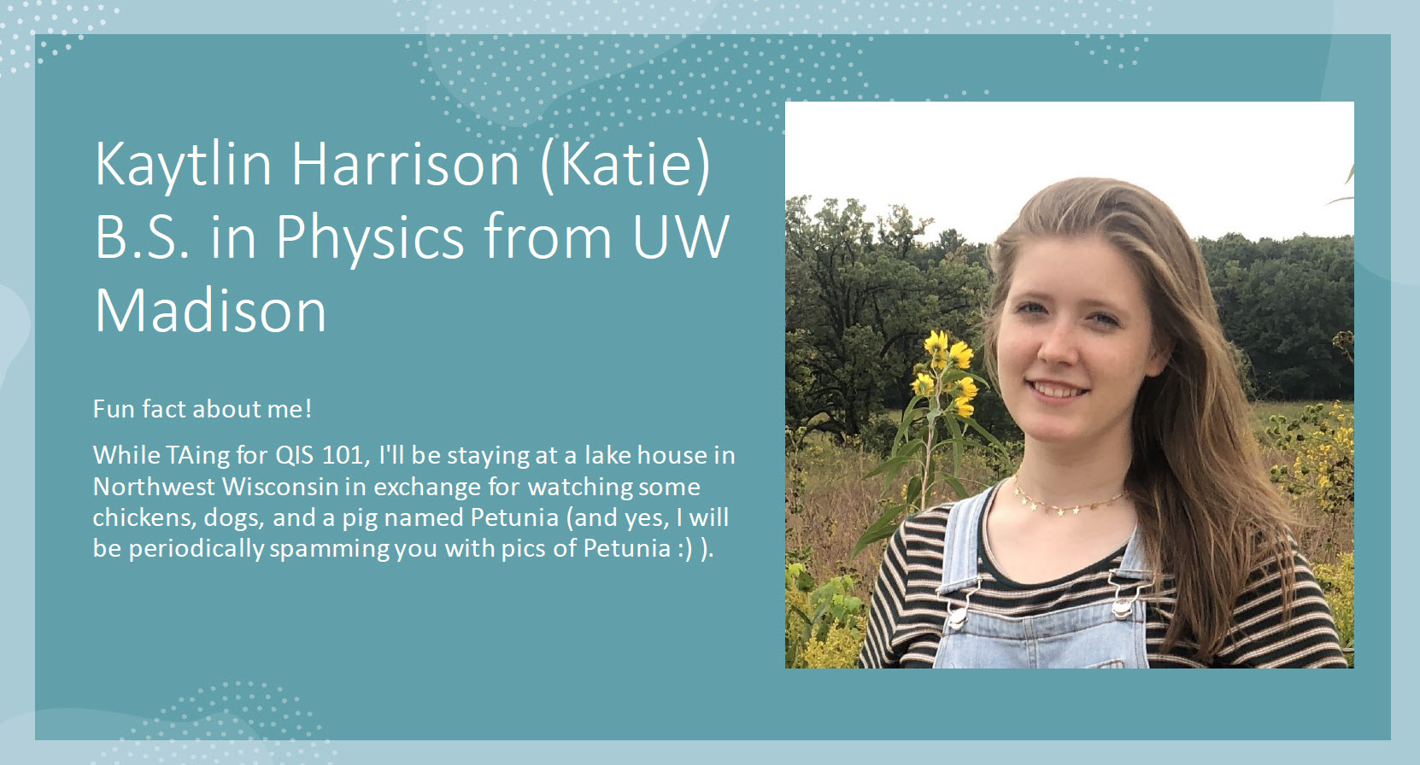
Your Teaching Assistants

Slide 19

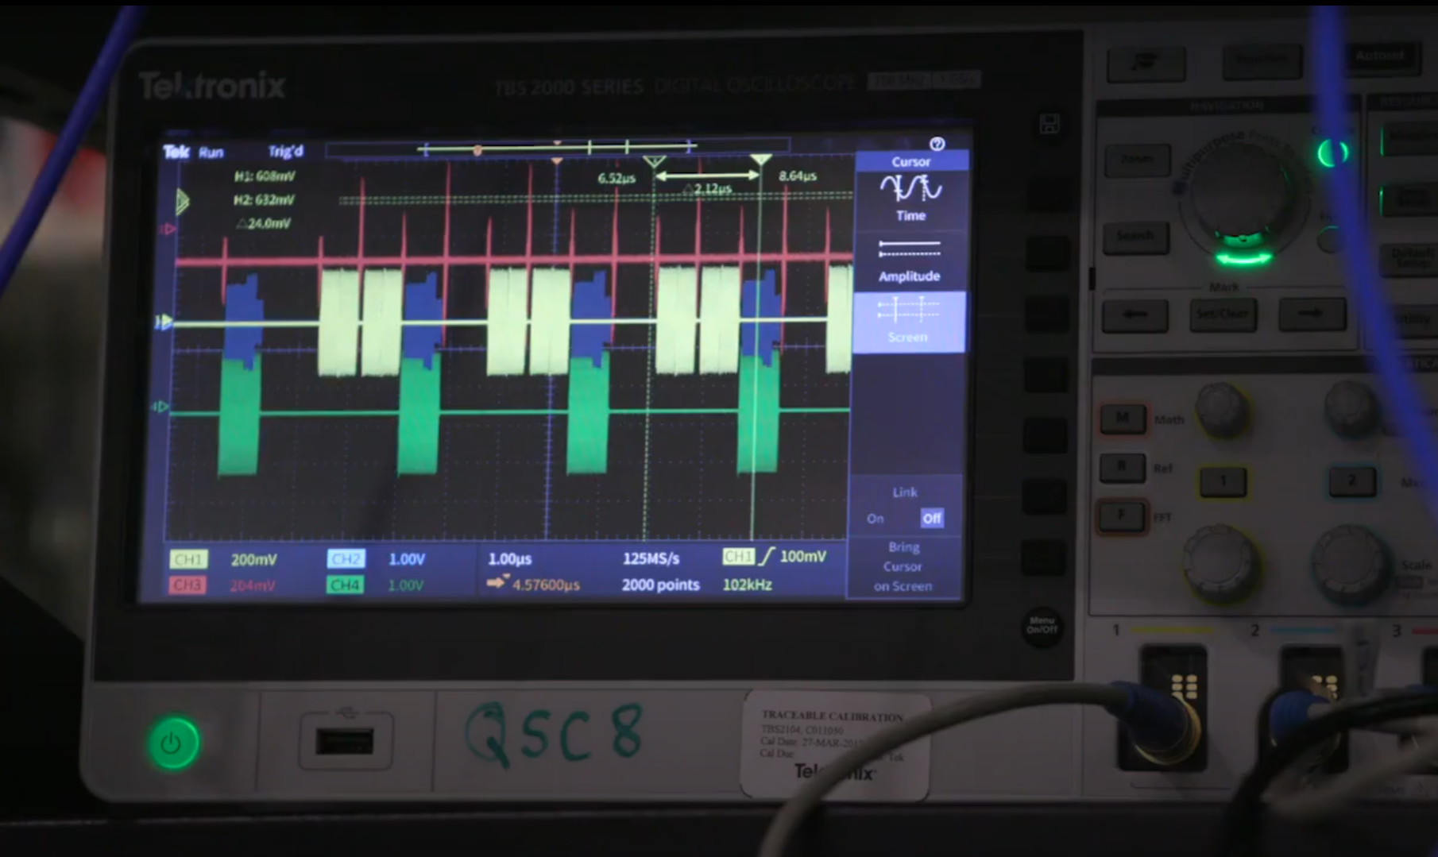
https://www.youtube.com/watch?v=ZOr0Ih6skMg

Slide 20
Quantum Computing vs. SciComp
There are specific problem domains where quantum computing can offer special advantages versus classical scientific computing – you simply cannot ignore it
However, QIS does not replace SciComp – much of the coding you will do in science will be classical programming
Be "spin adverse" – avoid overselling quantum computing – know the ground state and avoid pontificating QIS hype
Be smart enough to know that we don’t know – the future impact of quantum computing is unknown at this point
Don't rush into quantum programming if you don't know how to program classical computers

Slide 21
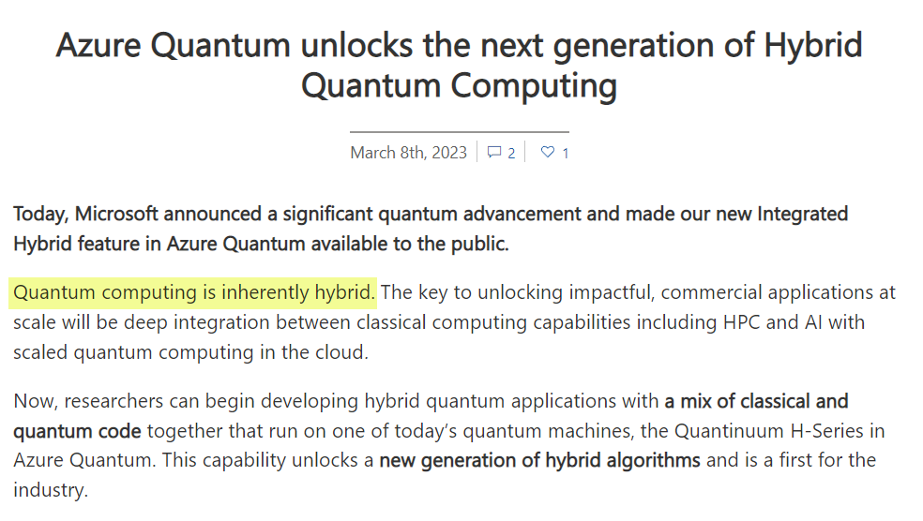
Quantum Computing vs. SciComp

Slide 22
From "Feel Good" to Solving Actual Problems
NOVA
HS
College
Grad
Post Doc
Nobel
Superficial
Wonder
Metaphors & Games
Mathematics
& Coding
Theory
& Problems
Experiments
& Questions
Discoveries
& Answers
QIS 101 is here
Undergraduates need to get a solid grip on the underlying mathematics of quantum computing
Playing is your first mode of learning, and it takes a lot of time to build an intuition on how to assemble the quantum circuits that power quantum algorithms
Most QIS curriculum is too heavily weighted on one end of the spectrum or the other - awareness doesn't equal skill

Slide 23
Be Spin Adverse
Leaning on "toy" metaphors has a definitive place in evangelizing knowledge about quantum computing, and in the early stages of student learning
However, over reliance on simplifying metaphors/games blocks the ability to map the approach to concrete mathematics
At some point you need to bring in complex algebra, matrices, and the concepts of phase & interference
How do we convey the marvel of quantum computing without overly accentuating the mystery?

Slide 24
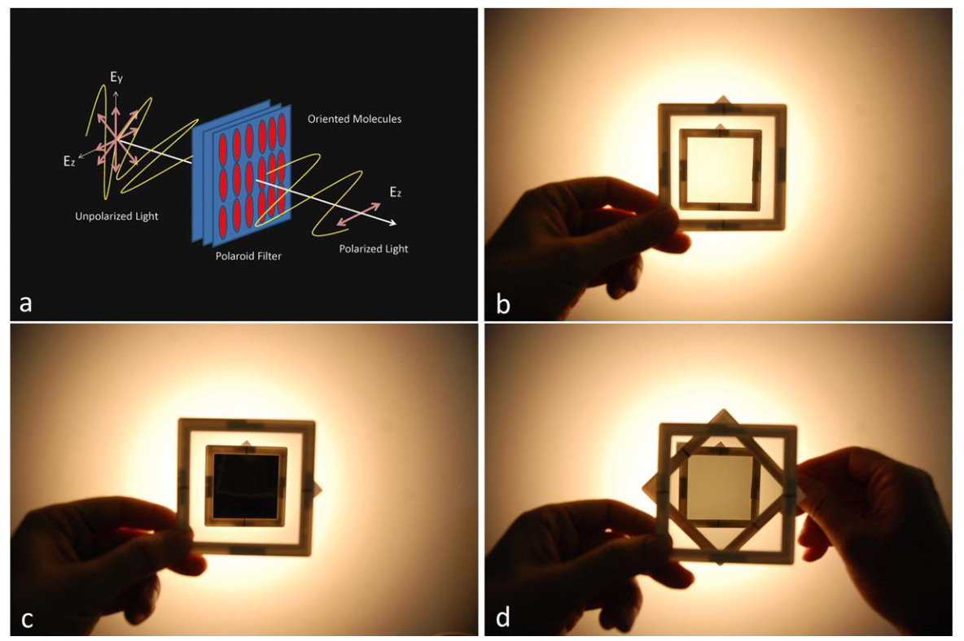
Click Bait Quantum Physics

Slide 25

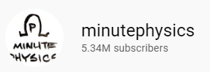
Click Bait Quantum Physics
https://www.youtube.com/watch?v=MzRCDLre1b4
In all seriousness, this is a good example and is rooted in solid mathematics, but it is a bit cliché and superficial – what do you learn from this?

Slide 26


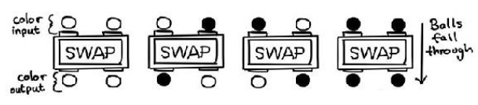
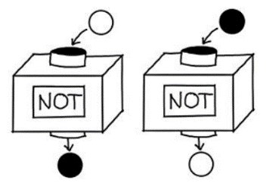
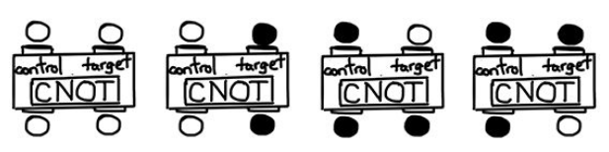
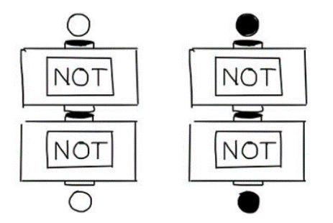
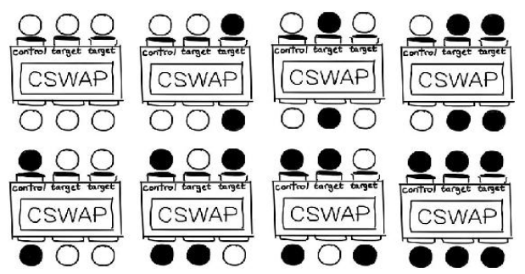
A Useful Introductory Metaphor
Terry Rudolph - Q is for Quantum
Activates if control is BLACK
Classical Boolean Logic and Gates

Slide 27
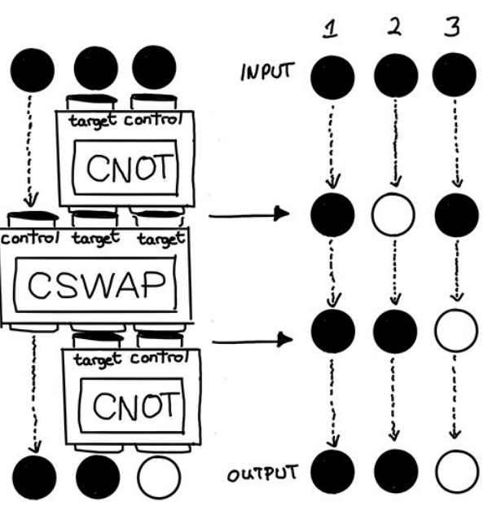
A Useful Introductory Metaphor
Terry Rudolph - Q is for Quantum
Classical Boolean Logic and Gates

Slide 28
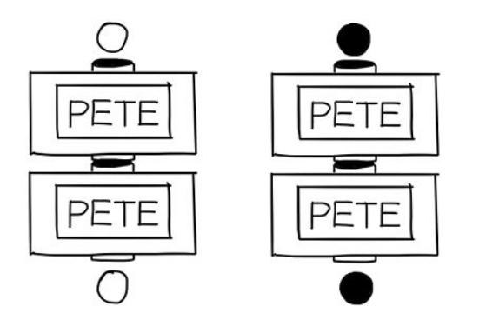
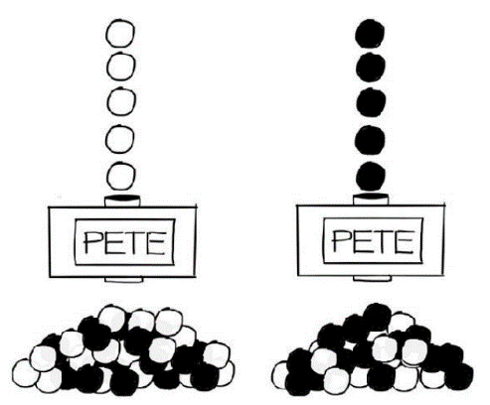
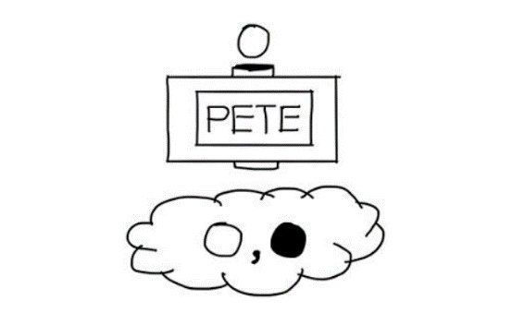
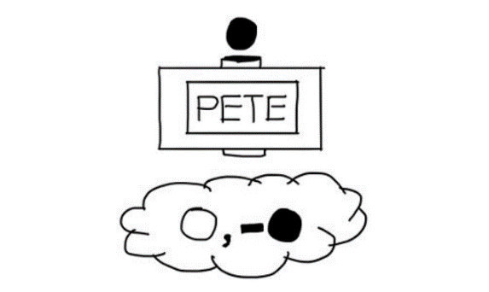
A Useful Introductory Metaphor
Terry Rudolph - Q is for Quantum
How is it always the same?
What about the 50/50?
Quantum Gates
50/50 – no way to force it
"Misty" State
Be mindful of the negative sign!

Slide 29
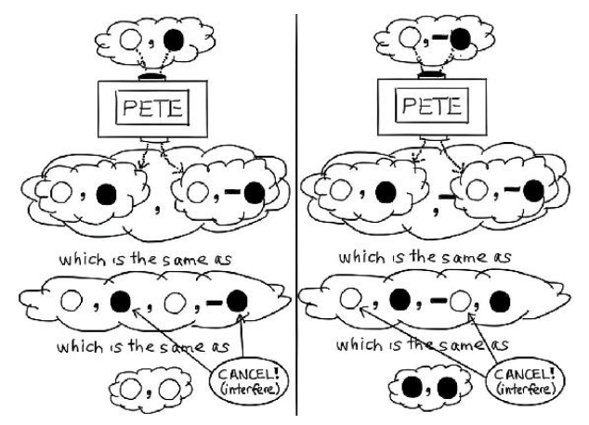
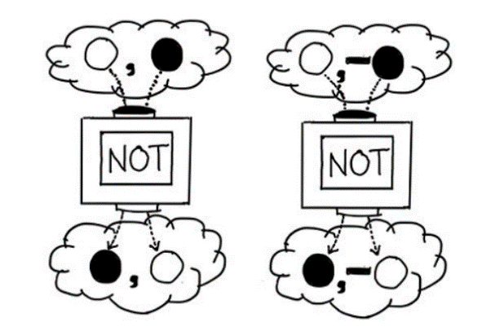
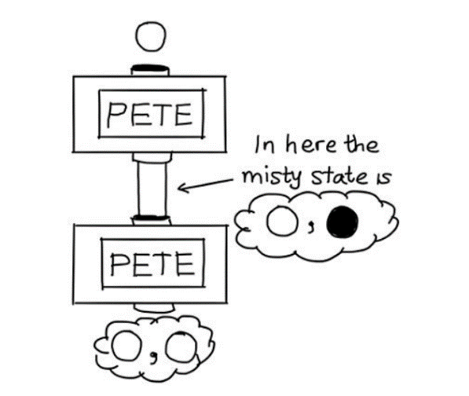
A Useful Introductory Metaphor
Terry Rudolph - Q is for Quantum

Slide 30
Quantum Information Science 101 Foundations of Quantum Computing
Objectives
Provide patterns for solving real-world science problems by writing custom software
Demonstrate how scientific computing impacts all science disciplines – and the areas where quantum computing matters
Enable students to translate scientific formulas into correct and efficient code
Place quantum computing on solid mathematical foundation
Explain the basis for quantum computing advantages & challenges
Prepare students to conduct interdisciplinary research at world-class institutions

Slide 31
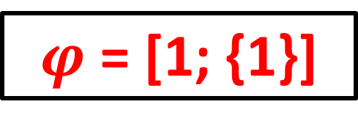
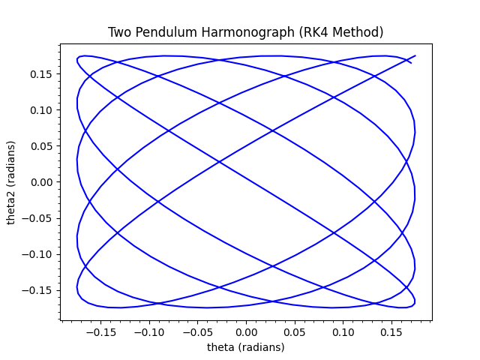
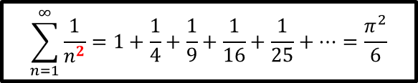
Mathematical Concepts
Probability Distributions
Calculus of Statistics
Complex Exponentials
Numerical Analysis
Differential Equations
Matrix & Tensor Algebra
Linear Regression
Monte Carlo Sampling
Wave Equations
Fourier Analysis
Dynamical Systems
$$\sum_{n=1}^{∞}{\frac{1}{n^{2}}=1+\frac{1}{4}+\frac{1}{9}+\frac{1}{16}+\frac{1}{25}+…=\frac{π^{2}}{6}}$$

Slide 32
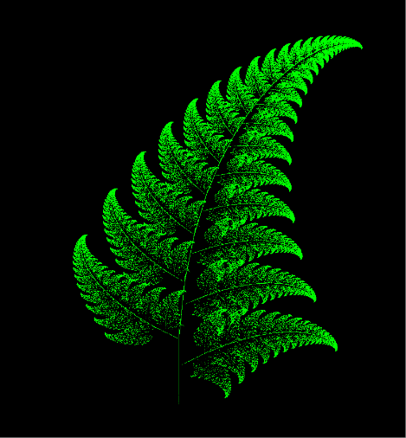
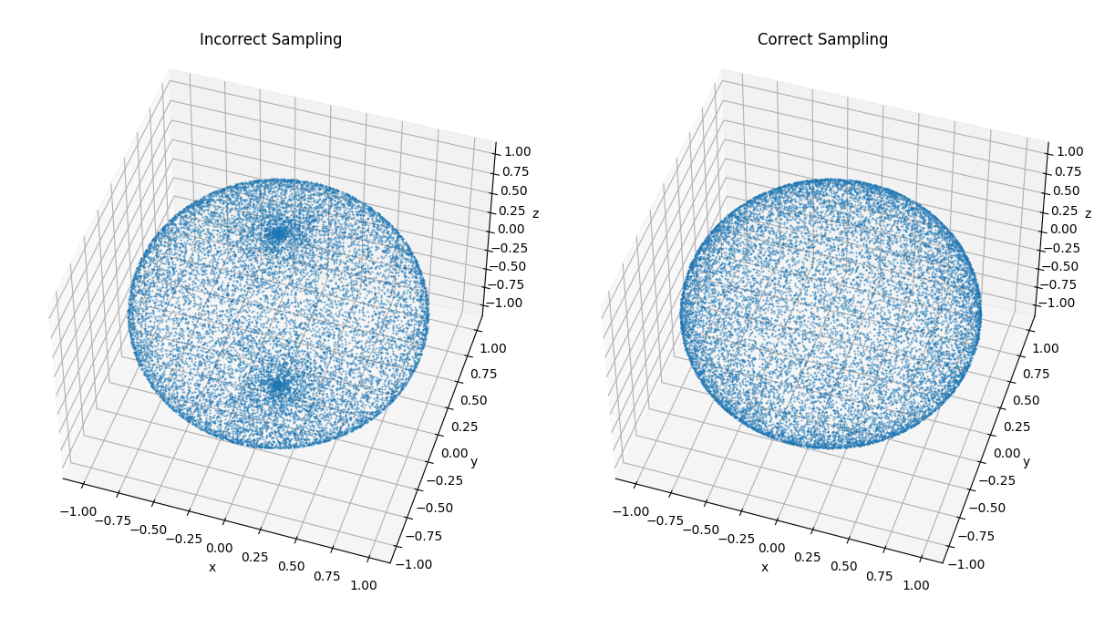
Computer Science Concepts
Representations and Encodings
Strings, Arrays, Operators
Loops, Functions, Recursion
Searching & Sorting
2D and 3D Graphics, Animation
Accuracy & Precision
Runtime Complexity
IBM Qiskit
Quantum Algorithms
Cybersecurity

Slide 33
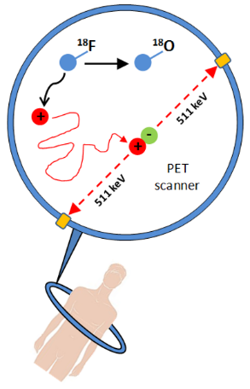
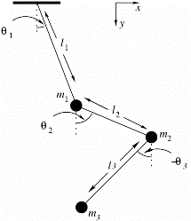
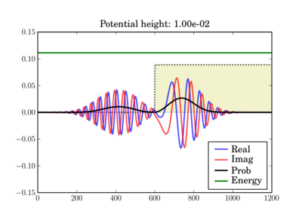
Science Concepts
Early Quantum Mechanics (Bohr)
Waves (Nyquist Theory)
Mechanics and Kinematics
Projectile Motion
Radioactive Decay
Schrodinger Wave Equation
Hamiltonians & Observables
Entanglement & Superposition
Quantum Gates & Circuits
Random Walks
Equilibrium & Thermodynamics

Slide 34
Scientific Computing with Python
Python is quickly becoming one of the most heavily used languages in science projects
Python runs on all major modern operating systems and is completely free and open-source (not vendor controlled)
Python makes it easy for your code to directly integrate with a large spectrum of available 3rd party software
Python code runs consistently on different platforms and scales well from small IoT devices to large server clusters
Python benefits from a very active and growing user community that continues to enhance the language

Slide 35
Useful Python & Qiskit Reference Sites
https://docs.python.org/3/tutorial
https://www.learnpython.org
https://realpython.com
https://www.w3schools.com/python
https://www.fullstackpython.com
https://qiskit.org/learn
https://www.youtube.com/qiskit

Slide 36
What makes Quantum Programming Hard?
The domain of achievable quantum solutions is not universal
It requires more mathematics than basic algebra – just getting started requires a significant time investment
Expensive, specialized hardware is required for extensive testing and optimization of large-scale algorithms
Incorporating reversibility in algorithms is a requirement, things like a = b are not allowed without ancilla bits
QIS vernacular is often riddled with highfalutin mumbo jumbo – it is easy to get smitten with pompous complexity… some recent textbooks are just unreadable
We've been teaching geometry for 3,000 years – QIS… 10

Slide 37
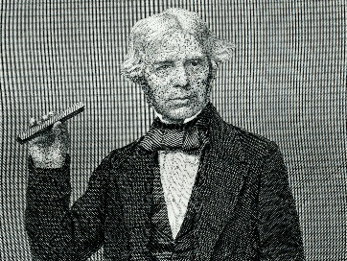
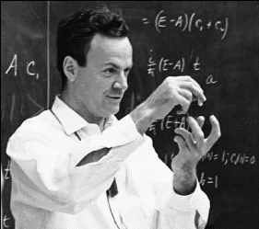
My Style
I am plain spoken and prefer concrete examples
It is not what you know, but what you can teach others
Leave your ego at the door – intellectual show-offs aren't impressive
It is bad if only the rich get richer but it is worse if only the smart get smarter, so remain a lifelong humble learner!
This isn't coffee and donuts time
If you wanted to be guided, you should have joined a safari - we turned down many other qualified applicants for you to be here
You are getting paid to learn so don't treat this like just another college course. This is a work environment, and your TA is your boss
BNL is a national treasure – remember that in all your efforts here

Slide 38
My Style
Don't interrupt the class just to state questions designed to impress everyone with your superior intelligence
Spouting trendy buzzwords that you don't truly understand just shows you're an accomplished parrot
Always feel free to ask sincere questions
Avoid the "my code doesn't immediately work so I will wait to be rescued…" trap – there are no victims here
If it doesn't work, dig in and research a solution (sending a screenshot and asking for help should not be your first reaction)
Stop trying to memorize everything – learn to glide with it!
Don't suffer in silence, but don’t expect to become a wizard after spending ~180 hours – it takes 500 hours to be an expert beginner

Slide 39
Reasonable Expectations
We all learned how to read before we learned how to write
Many junior BNL staff inherit existing code to fix or extend
Annotate my source code with your own words!
Programming is a very precise science
However, there is never just one way to solve a problem
Variability is an unsettling but necessary complication
Your assigned TA will report to BNL your daily session attendance and will judge the quality of your results
If you cannot make a session, please inform your TA
Do not fall behind – each session builds off the next!

Slide 40
Quantum Information Science 101 Foundations of Quantum Computing

Slide 41
Quantum Information Science 101 Foundations of Quantum Computing

Slide 42
Quantum Information Science 101 Foundations of Quantum Computing

Slide 43
Quantum Information Science 101 Foundations of Quantum Computing

Slide 44
Quantum Information Science 101 Foundations of Quantum Computing

Slide 45
Quantum Information Science 101 Foundations of Quantum Computing

Slide 46
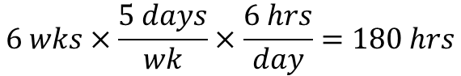
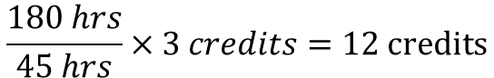
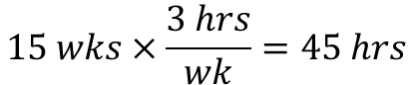
Quantum Information Science 101 Foundations of Quantum Computing
$$6 wks×\frac{5 days}{wk}×\frac{6 hrs}{day}=180 hrs$$
$$15 wks×\frac{3 hrs}{wk}=45 hrs$$
3.0
Credit Hour
Course
$$\frac{180 hrs}{45 hrs}×3 credits=12 credits$$
QIS101 is the equivalent of a taking a 12.0 credit hour college course!
But you are getting paid ☺

Slide 47
Quantum Information Science 101 Foundations of Quantum Computing
If you do not regularly attend the Zoom sessions (from beginning to end) and/or you fail to upload solutions into your folder in the QIS101 SharePoint site, you will be dropped from this workshop and receive no further weekly stipends
You are getting paid by the US Taxpayers, and Department of Energy HQ requires BNL to submit your deliverables each week! No one gets a free ride – it would not be fair to the other students who are investing the time and making the effort
Please proactively communicate with your TA and obtain their prior approval to miss any Zoom sessions or to submit late/incomplete solutions

Slide 48
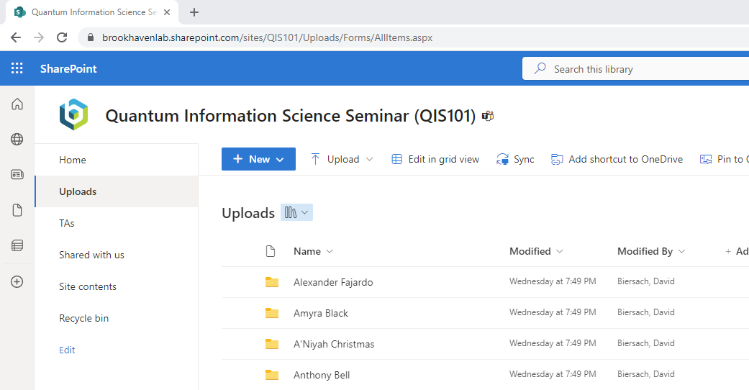
Quantum Information Science 101 Foundations of Quantum Computing
https://brookhavenlab.sharepoint.com/sites/QIS101/Uploads

Slide 49
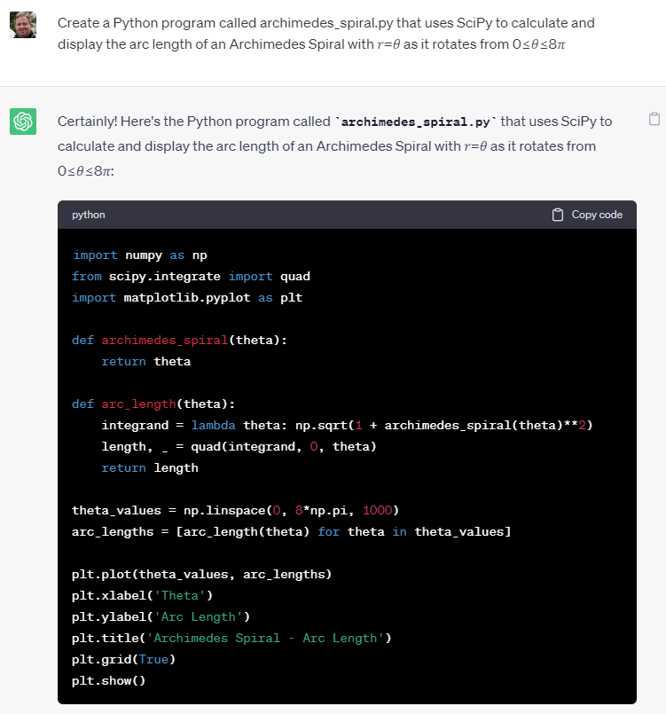
What about ChatGPT?
As of June 2023, ChatGPT can create starter code for 31 out of the 51 QIS101 tasks!
I encourage you to use ChatGPT to learn, but be sure its proposed solution satisfies the requirements, and you must always give proper attribution
Just be mindful if you are truly learning when using ChatGPT

Slide 50
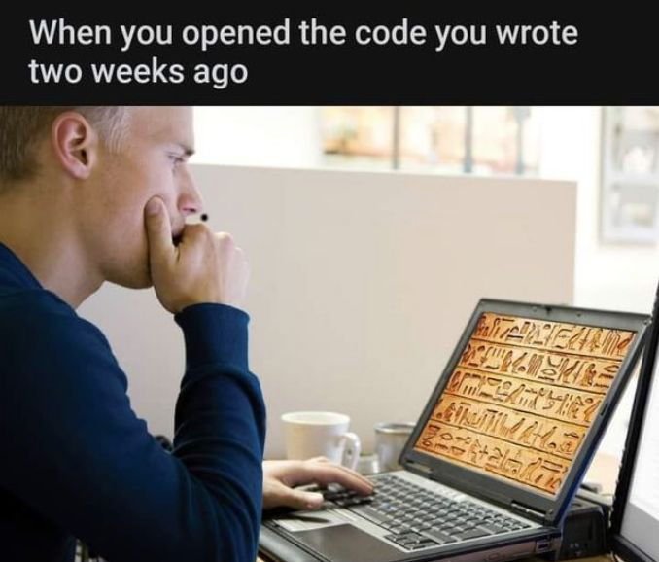
Document My Code & Yours
You will be evaluated according to the quantity and quality of the comments you put into your source code

Slide 51



Grit Beats Wit
To earn a BNL Certificate and my letter of recommendation, you must attend most sessions and attempt every task

Slide 52

Join Our Discord Channel
https://discord.gg/EpjZQwQm

Slide 53

Know the Greek Alphabet

Slide 54


Know the Double Struck Letters
$ℕ$= Natural Numbers (1, 2, 3)
$ℤ$ = Integers (-3, -2, -1, 0, 1, 2, 3)
$ℚ$ = Rational Numbers ($ℤ/ℤ$)
$ℝ$ = Real Numbers (decimals)
$ℂ$ = Complex Numbers (Re + Im)
Think Q for quotient
$$ℕ∈ℤ∈ℚ∈ℝ∈ℂ$$

Slide 55
Final Thoughts
It does not take thousands of lines of code to keep importance science moving right along…
You don’t have to be a professional programmer or know all the arcane aspects of computer languages
The closer you get to cutting edge science, the less likely you’ll be able to just “download an app” to accomplish what you need
If you don’t know how to code…
You will at some point start to subconsciously limit the types of analysis you can perform because you will remain at the mercy of the available software
Should software shape your science, or instead, will you shape software to advance your science?

Slide 56


Slide 57

TASK 01-01
Develop a closed form (analytic) expression for $f\left(n\right)$ that generates this sequence where $f(1)=2,f(2)=−1, etc$:
$$2, −1, 1, −\frac{1}{2}, \frac{2}{3},−\frac{1}{3},\frac{1}{2}, −\frac{1}{4},\frac{2}{5},−\frac{1}{5},\frac{1}{3},−\frac{1}{6}, …$$
Where $n∈ℝ$ (not just $n∈ℕ)$ and $f\left(n\right)$ is not a piecewise function
Having the above expression for $f\left(n\right)$, find the value for:
$$\sum_{n=1}^{1000}{f(n)}$$
What is your proposed value for $f\left(−2.7\right)$? - Required
Upload your solution to the BNL QIS101 SharePoint site

